Slide 1

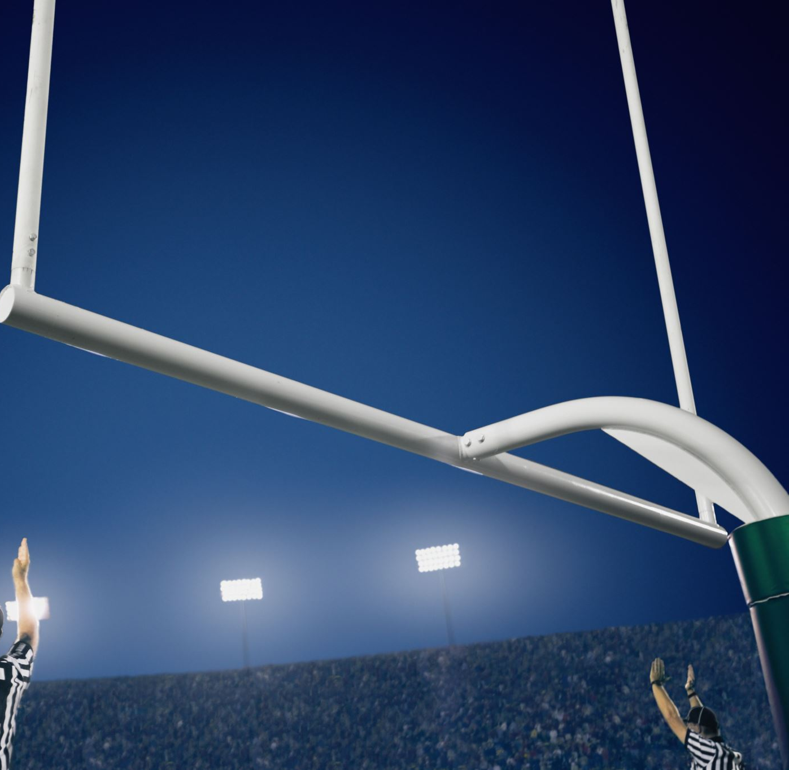
FANTASY FOOTBALL PLAYER ANALYSIS
Machine learning , linear regression and visuals A David Chrobak Presentation

Slide 2


Background of the Virtual Gridiron
In 1962 when Bill Winkenbach, then part owner of the Oakland Raiders football team, gathered with some friends in a New York City hotel, and together they created the first fantasy football league, which was dubbed the GOPPPL (Greater Oakland Professional Pigskin Prognosticators League). Little did they know the mammoth of an industry it would later become.
Although Fantasy sports(Draft Kings) have recently emerged in the last decade on major publishing titles such as Forbes, as it has become even more poplar after its public listing in 2012 and still currently trades on the NASDAQ, the First Virtual Fantasy team was actually created years earlier in 1985.
According to an article from business wire, the projected market value for Global Fantasy sports for 2022 is $20.14 billion and is projected to reach $34.66 billion by 2027.
Of course Fantasy football makes up the for the largest segment of the market share, showcasing multiple platforms, interfaces and gameplay.
Who would have thought that a fake team with real players would earn more money than a real organization. That's right! the Dallas Cowboys the NFL's highest valued Team is 'only' worth $7.64 billion as of 2022. A little more than a third of the Global Fantasy market projections for 2022.

Slide 3
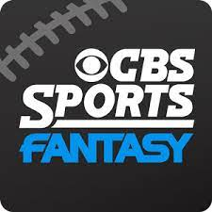


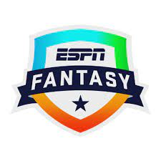


Platforms

Slide 4
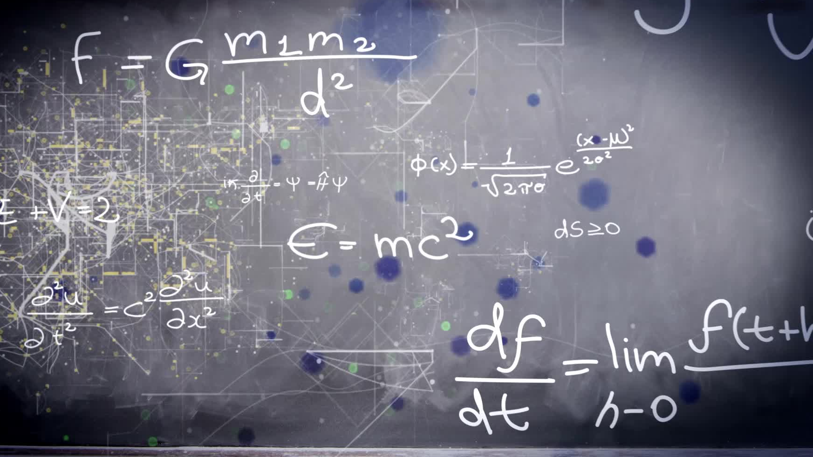
Objective
My objective was to create a machine learning model that would correctly predict the Total Fantasy points peR player FROM 2014-2022. given the parameters.
as well as to further analyze the player data to garner insights, kpis and useful information.

Slide 5
Scores ( Touchdown???)
Linear Regression
KNN
Random Forest
Random Forest Hyper-tuned
R2 - 0.815
R2 - 0.398
R2 - 0.9812
R2 - 0.9817

Slide 6

THE EXPENSIVE MISTAKE
https://public.tableau.com/views/FinalProject_16610315787450/Dashboard1?:language=en-US&:display_count=n&:origin=viz_share_link

Slide 7

KPI’s and Findings
Salary Heavily Impacts the players Fantasy Points Year over Year
Wide Receivers Are the Highest Scorers
New England has the Most Players with Fantasy Points
Yards and touchdowns mean nothing to the model
* Could have Removed Rushing Touchdowns

Slide 8
Conclusion
The data was mostly clean
Random Forest using hyperparameter tuning was the best score at 98%
Again, rushing yards could have been Removed
Money Talks
A RANKING SYSTEM CAN be developed using salary alone for a fantasy draft
I will be testing this season, Wish me Luck
ULTIMATLEY THIS COULD BENEFIT BOTH THE PLAYER BUT MAINLY THE BETTING PLATFORMS.
KNOWING HOW MANY POINTS A PLAYER MAY SCORE EACH GAME WOULD BE THE ULTIMATE CHEAT GUIDE.

